Slide 1
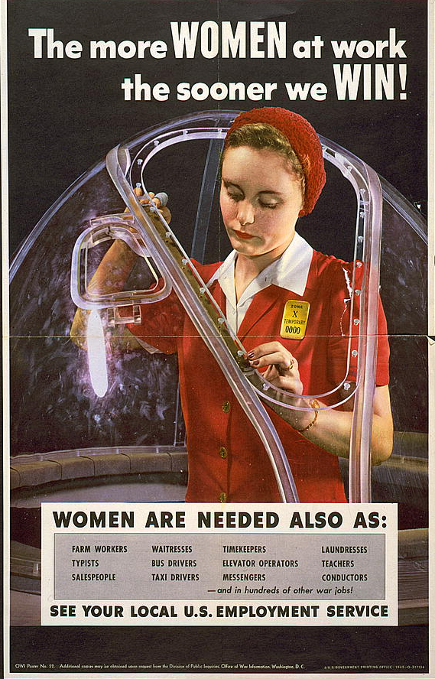
Women in the War Effort
Took over many jobs for servicemen, most notably in heavy industry
Some joined the military
Altered family life, brought several drawbacks
A poster urging women to take manufacturing jobs to help the war effort
Notes:
With millions of American men either enlisting in the armed forces or drafted, women had to take over many jobs usually performed by men, such as working in heavy industry, manufacturing tools of war including tanks, planes, and other materiel. The image of “Rosie the Riveter” became commonplace as women soon became the backbone of American industry during the war years.
Other women sought a more active role in defense by joining specially created women’s units in the armed forces. Many joined the WACs, WAVEs, SPARs, and other related units, filling many noncombat positions both stateside and overseas. Women also served as drivers, clerks, communications officers, pilots, and nurses. Thirty nurses were killed in action during World War II.
However, while many women became the family breadwinner and proved that they could work as hard as their male counterparts, wartime employment had substantial drawbacks. The divorce rate increased substantially, as did juvenile delinquency among females. The incidence of alcoholism among women also grew. Many women had to uproot themselves and their families to relocate to communities that provided more defense-industry opportunities. A new generation of “latchkey kids” frequently found itself without parental guidance or supervision, perhaps with fathers in the military and mothers working a shift at a defense plant.
1

Slide 2
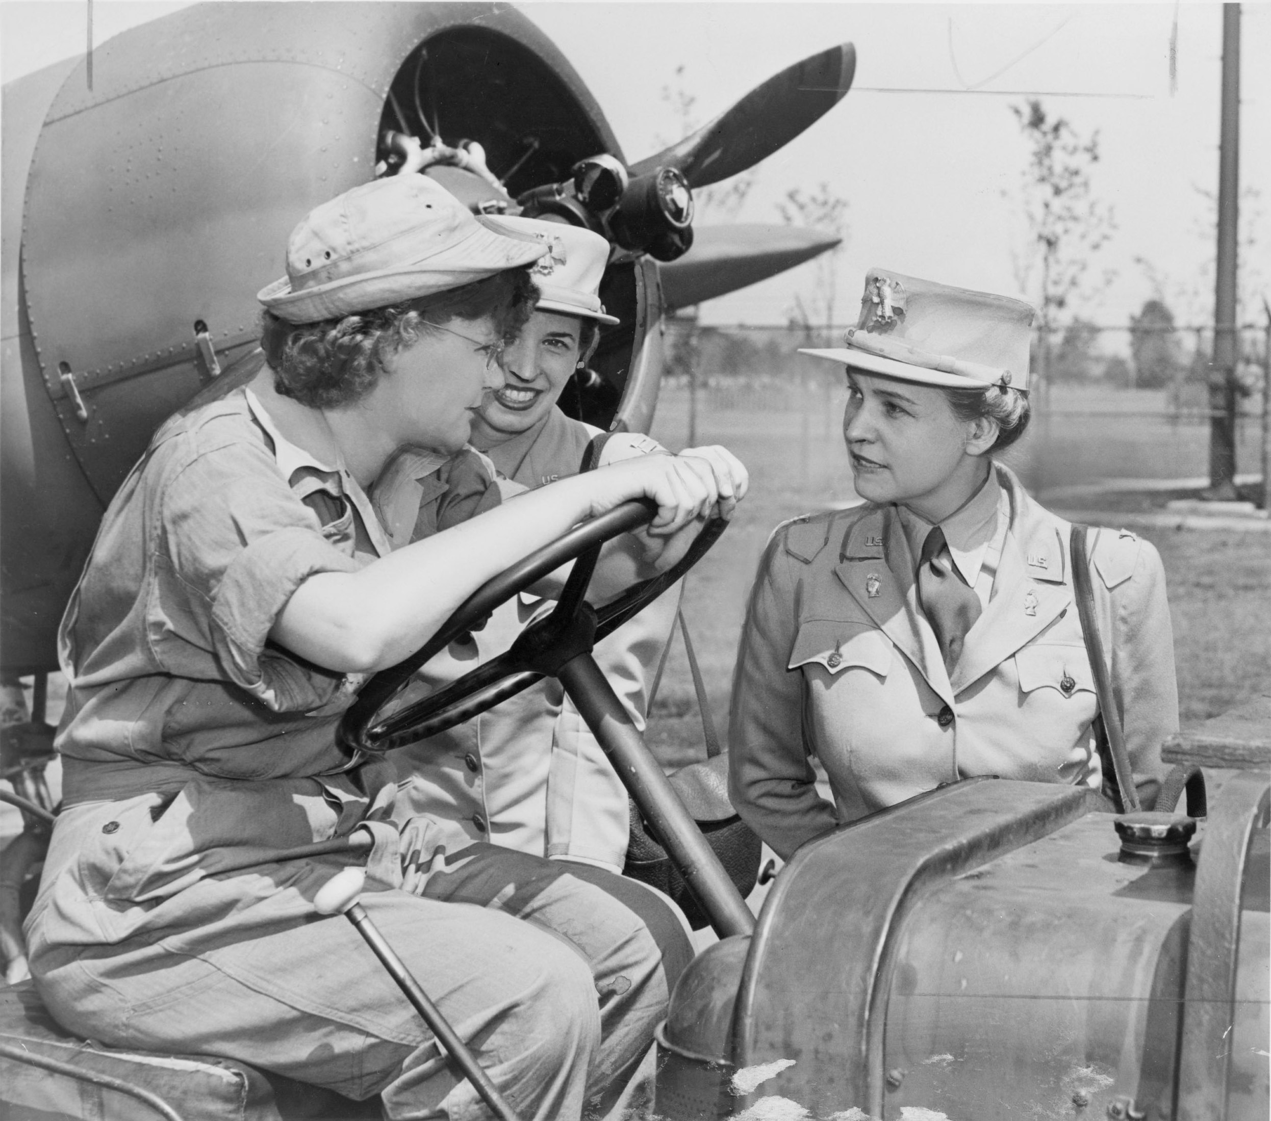
The Women’s Army Corps
Marshall noted British success in using women for noncombat duties
Congress created Women’s Auxiliary Army Corps in 1942
WAAC later renamed “Women’s Army Corps”
WAC Director Col. Oveta Culp Hobby (right) confers with WAC members at Mitchell Field, NY
Notes:
U.S. military leaders saw in the early days of the war that the female population could provide significant military service as well. Impressed with the British army’s incorporation of women in military service, Army Chief of Staff George C. Marshall became a main proponent of a women’s unit for the U.S. Army. With his backing, and at the urging of other women leaders including First Lady Eleanor Roosevelt, Congress created the Women’s Auxiliary Army Corps (WAAC) in May 1942. Congress upgraded the WAAC to full military status within a year, renaming it the “Women’s Army Corps” (WAC).
WACs (as corps members were informally known) contributed to the war effort by performing more than 200 noncombat jobs, including operating switchboards, driving staff cars, and sorting mail. The military stationed WACs at more than 400 mainland military bases as well as in both the European and Pacific theaters. By the end of the European war, the WACs had more than 100,000 members, including more than 6000 commissioned officers.
The army named as director Oveta Culp Hobby, wife of former Texas Governor William Hobby and head of the War Department’s Women’s Interest Section. After the war, she became the first secretary of the newly created Department of Health, Education, and Welfare (later, the Department of Health and Human Services).
2

Slide 3
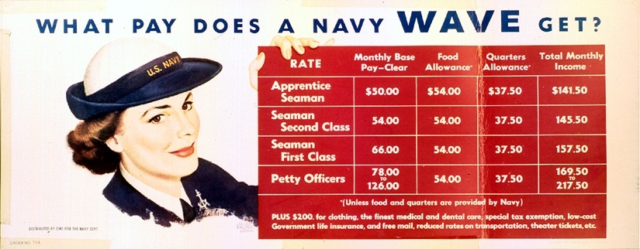
WAVEs
“Women Accepted for Voluntary Emergency Service”
Navy program similar to WACs
Did not serve overseas
Nurses, clerical work, communications jobs
A WAVES recruitment poster explaining the pay scale for members
Notes:
With the WAAC established by summer 1942, the navy followed suit with a similar program, called “Women Accepted for Voluntary Emergency Service” (WAVES). Although an official part of the navy, the program’s name indicated its temporary nature; after the war ended, members would be discharged.
The navy stationed WAVEs (as individuals were called) only in the continental U.S. or in U.S. possessions such as Hawaii. They did not serve in any combat zones. Most WAVEs worked as nurses, in communications jobs and clerical positions, and as storekeepers. The U.S. Coast Guard established a similar program, called “SPAR,” after the initials of that branch’s motto, “Semper Paratus” (“Always Ready”).
In 1948, Congress disbanded the WAVEs by passing the Women’s Armed Services Integration Act, which gave women permanent status in the armed forces. However, most female recruits were known as WAVEs for much of the 20th century.
3

Slide 4
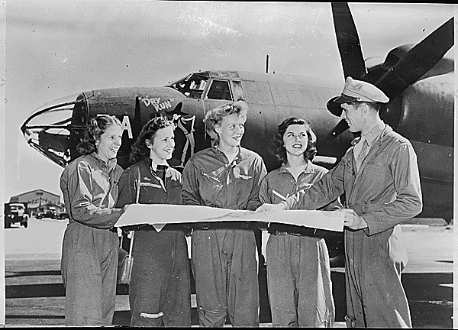
WASPs
“Women’s Airforce Service Pilots”
Aviators Cochran and Love proposed idea separately
Performed noncombat flight duties
Freed male pilots for combat missions
Four WASPs receive final instructions as they chart a cross-country course
Notes:
Although the military barred women from participating in naval or ground combat operations, they still provided valuable service to the U.S. armed forces in noncombat roles. Female aviators did the same through their service in the Women’s Airforce Service Pilots program.
Two well-known pilots, Jacqueline Cochran and Nancy Harkness Love, independently proposed such a program prior to Pearl Harbor. While the Army Air Corps rejected these early submissions, the entry of the U.S. into WWII changed the position of General Henry “Hap” Arnold, as well as other military leaders. Women worked as civilian flight instructors, as well as ferried planes from factories to airfields. Female pilots towed airborne targets for anti-aircraft drills, simulated strafing drills, and transported cargo. Perhaps most importantly, the contributions of the WASPs made male pilots available to participate in combat.
Unlike the WACs and WAVEs, Congress failed to pass legislation giving the WASPs equal military status with the all-male Army Air Corps. Considered civilian civil-service employees, the WASP corps was disbanded in late 1944. Only in the late 1970s did the U.S. government retroactively give the WASPs equal military status, recognizing female pilots for their service.
4

Slide 5
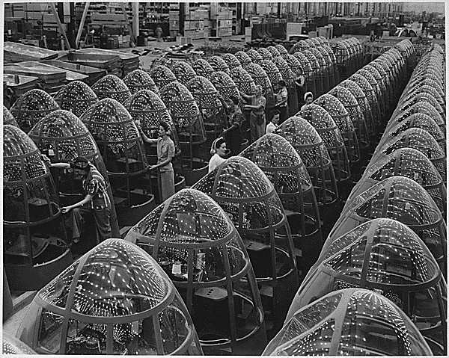
Women in the Workforce
Women were encouraged to work in defense plants
Others grew Victory Gardens and helped with recycling for the war effort
Generally earned less than male workers
Factory workers polish Plexiglas nose cones for A-20 attack bombers
Notes:
Although some women joined the military during the war, most found they could assist the war effort by working in the private sector. By war’s end, nearly 18 million women worked outside the home—one-and-a-half times the number that had performed similar labor in 1939.
The shortage of male workers led employers to suggest that women’s work as homemakers had adequately prepared them for work in industry. The majority of women working in defense plants earned much less than their male counterparts, though many used to working as homemakers without pay accepted lower salaries without question.
Many married women with the responsibility of raising children as well as managing the home, stayed housewives. However, they contributed to the war effort by growing Victory Gardens (which fed the family and freed food resources for troops’ consumption) and working in recycling drives, as well as buying war bonds.
5

Slide 6
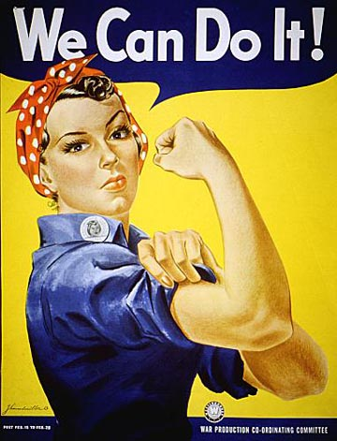
“Rosie the Riveter”
A symbol of working women during the war
Based on factory worker Rose Will Monroe
Miller and Rockwell both created iconic “Rosie” images
This poster for the Westinghouse Corporation is frequently associated with “Rosie the Riveter”
Notes:
One of the most iconic images of the home front was that of “Rosie the Riveter,” a symbol of the power of the working woman to help achieve victory in World War II. Though the famous “We Can Do It!” poster (by artist J. Howard Miller) is credited as one of the first uses of “Rosie” in wartime propaganda, Miller did not intend to associate his image with the character; Miller created the poster as a motivational tool for the Westinghouse Corporation, not the federal government.
An actual factory employee, Rose Will Monroe, likely inspired the character of “Rosie the Riveter.” She worked as a riveter at Michigan’s Willow Run Aircraft Factory. Several government posters encouraging women to work in defense plants featured her picture, and the government also sponsored a promotional film starring Monroe.
Illustrator Norman Rockwell drew another famous conception of “Rosie”—this time a welder—for the cover of the May 29, 1943, issue of The Saturday Evening Post. The original painting later sold at auction for nearly $5 million.
Regardless of the character’s origin, the “Rosie” image helped spur women to help in the war effort by taking on industrial jobs that had previously gone to men.
6

Slide 7
Discussion Questions
What role did General George C. Marshall play in mobilizing the armed forces early in the war?
How did women contribute to the U.S. war effort?
Notes:
Marshall became Army Chief of Staff in late 1939, in which position he secured major increases in funding for the armed forces, fearing an eventual conflict with a remilitarized and expansionist Germany. He convinced the government to appropriate $9 billion by May 1940, and also to pass the Selective Service Act, which instituted a peacetime draft and grew the size of the army from 190,000 to several million at its height.
Women played a major role in the mobilization of the country in the war effort as well as maintaining the wartime economy. Women joined various branches or subsidiary organizations of the armed forces, including the WACs, WAVEs, SPARs, and WASPs. They also joined the workforce in large numbers and in various industries—some for the first time, such as in airplane or munitions plants to help maintain domestic lifestyles while producing needed tools of war. “Rosie the Riveter” became a common emblem of American life, and many families depended on the woman’s income.
7

Slide 8
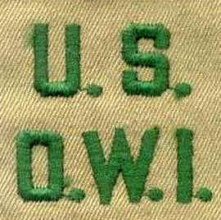
Office of War Information
Established in 1942
Coordinated release of war news
Promoted patriotism
Tried to recruit women into factory work
Propaganda program abroad
The Voice of America
Patch worn by Office or War Information personnel
Notes:
As the government worked to mobilize industry and manpower for the war effort, it also took steps to prepare the nation psychologically for a difficult struggle. This task fell to the Office of War Information, established in 1942. The OWI played several roles. One involved coordinating the release of war news via censorship and control of the media. In most instances, the OWI promoted media self-censorship of the media, which complied with many restrictions regarding troop movements, military campaigns, and so on.
The OWI worked to promote patriotism through various means, including posters, propaganda films, and radio shows—many featuring some of the era’s bigger celebrities. Similarly, the OWI helped to recruit women to work in the defense industry. The OWI also worked to educate foreign populations about “American democracy” through an international propaganda program, specifically with the Voice of America, a radio network that broadcasted American news and music to various nations in Europe, as well as to other parts of the world.
With the end of the war came the end of the need for the OWI, and it dissolved in
late 1945.
8

Slide 9
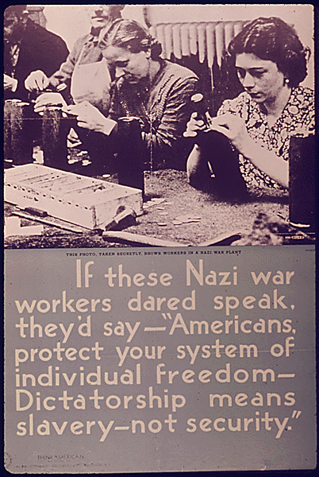
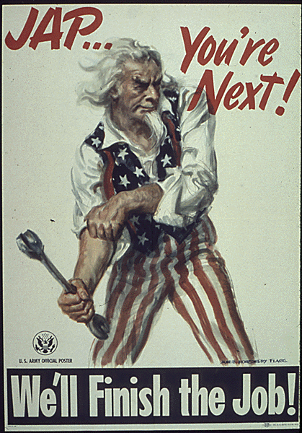
Wartime Propaganda Posters
Government propagandists sometimes used fear and racial slurs in order to convey their message
Notes:
Discussion questions:
Ask students to identify specific elements that make these posters propaganda. Ask students to speculate as to how effective posters such as these might be in keeping patriotism high and focusing American attention on the war effort.
Students may look at the image of Uncle Sam rolling up his sleeves (a symbol of getting down to work), as well as the Nazi workers, as good methods of propaganda, although the Nazi war workers picture is somewhat subdued compared to the picture of Uncle Sam. However, the use of the word “slavery” in the Nazi war workers poster may lead students to note that Americans who read that poster might be concerned about losing basic freedoms if the Nazis won the war.
9

Slide 10
Donald Duck in Nutziland
Chorus to “Der Fuehrer’s Face”:
When der fuehrer says we is de master race We heil heil right in der fueher's face Not to love der fuehrer is a great disgrace So we heil heil right in der fuehrer's face
Produced by Disney in 1943
Donald Duck dreams he works on a German munitions line
Bandleader Spike Jones recorded “Der Fuehrer’s Face”
Name of cartoon later changed to reflect song title
Notes:
While the government churned out propaganda posters in order to maintain popular support for buying war bonds and the war effort, movie studios did the same. Disney Studios produced one of the most famous examples of pro-U.S. propaganda in 1943, a cartoon originally titled Donald Duck in Nutziland. In the cartoon, Donald Duck has a nightmare that he is living in Nazi Germany, working in a German munitions plant, dealing with what the Disney Studios portrayed as life in a dictatorship, and “heiling” Adolf Hitler. At the end of the cartoon, Donald awakens back in the U.S., kisses his model of the Statue of Liberty, and proclaims that he’s glad he’s an American.
The cartoon became an instant hit, particularly after Spike Jones and His City Slickers recorded and released a version of “Der Fuehrer’s Face,” a song by Oliver Wallace featured in the cartoon. Disney later changed the cartoon’s name to reflect the song title. The Academy of Motion Picture Arts and Sciences also honored the cartoon, awarding it the Oscar for best cartoon short in 1943.
10

Slide 11
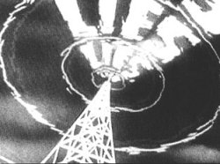
1940s Movies
Feature films included war themes
Nazis and Japanese portrayed as buffoons or villains
Patriotism also a common theme
Characters such as Sherlock Holmes and Tarzan battled Nazis
Documentaries by Capra and Wyler also popular
A scene depicting the Nazi propaganda machine, from one of Frank Capra’s Why We Fight films
Notes:
During the 1940s, Hollywood movie studios made films to promote the war effort and keep morale high. Many of the most popular films of the era featured either anti-war themes, or highlighted patriotism.
Many movies, such as Chaplin’s The Great Dictator and Jack Benny’s To Be or Not to Be portrayed the Nazis as fools and buffoons. Other films such as Casablanca had Nazis as villains. The Japanese received the same treatment in films such as Flying Tigers and They Were Expendable. Studios repurposed well-known movie heroes such as Sherlock Holmes and Tarzan (both 19th-century creations) to fight fictional Nazis.
Many movies from the era focused on life on the home front, including Mrs. Miniver and Since You Went Away. Other movies, such as 1942’s Yankee Doodle Dandy, starring James Cagney as American showman George M. Cohan, emphasized patriotism.
Documentary filmmakers produced many lasting works in the 1940s. Frank Capra’s Why We Fight series summed up the reasons for U.S. entry into World War II, and William Wyler’s Memphis Belle told the story of a U.S. bomber crew that successfully completed 25 missions against Germany.
11

Slide 12
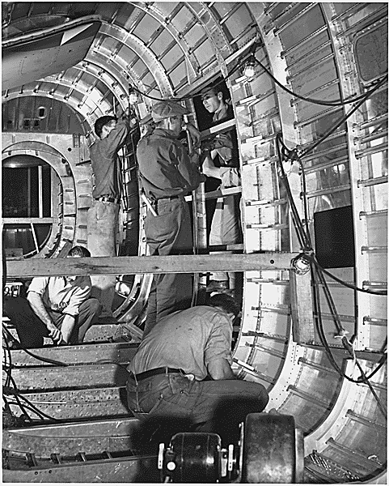
Mobilization of Industry
“Dr. Win the War” replaced “Dr. New Deal”
Many civilian industries converted to war production
Manpower needed for defense plants
Scarce goods rationed and price controls established
Disputes between management and labor to resolve
Workers assembling an aircraft
Notes:
Recovering from Pearl Harbor posed many significant military problems, but also posed significant problems on the home front as well. Used to federal regulation of the economy, Americans now found the government changing economic and industrial priorities to meet military needs—in the words of FDR, “ ‘Dr. New Deal’ [was] replaced by ‘Dr. Win the War’.”
To reach this goal, civilian industries converted to wartime production, which frequently required retooling factories and retraining workers. Factories needed more manpower (both male and female), especially to replace workers who enlisted into the armed forces or were drafted.
The sheer amount of products devoted to the war effort inevitably led to the scarcity of certain foods and goods. The government had to find a way to make sure that military populations would receive needed supplies, without subjecting civilian populations to extreme hardships.
Still another question concerned relationships between management and labor—how to maintain production without the threat of strikes.
12

Slide 13
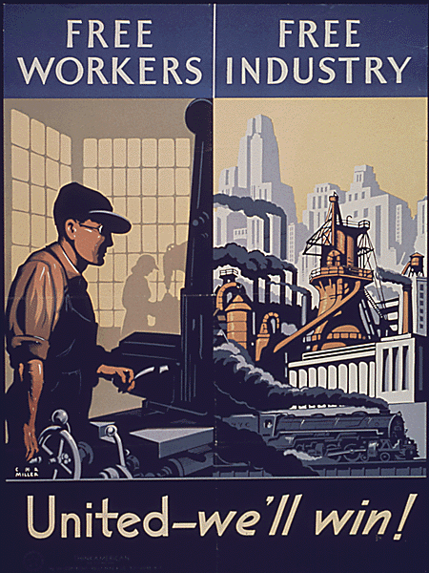
“A Production Miracle”
Axis Powers underestimated American production
Many factories and businesses converted to war production
New industries emerged
Output significantly increased
Notes:
One of the largest mistakes the Axis nations made was believing that most Americans would not tolerate shifting industrial production to build tanks, planes, and guns, instead of washing machines, automobiles, and radios. However, American industry and the public soon proved that they were willing to make sacrifices for the sake of victory.
Civilian automobile production ended two months after Pearl Harbor. Soon, automobile manufacturers had retooled and were producing airplanes and tanks. Other civilian industries did the same, and by 1942, war production involved one-third of the U.S. economy. American output of materiel equaled that of Germany, Japan, and Italy combined.
The war also spurred the expansion or creation of new industries. For example, Japanese-controlled territory contained most of the world’s supply of rubber. In response, the U.S. built nearly 50 synthetic rubber plants across the country. By war’s end, the U.S. had become the world’s largest importer of natural rubber to the world’s largest exporter of synthetic rubber.
All told, U.S. industry produced 300,000 military aircraft, 2.6 million machine guns, six million tons of bombs, and 86,000 warships.
13

Slide 14
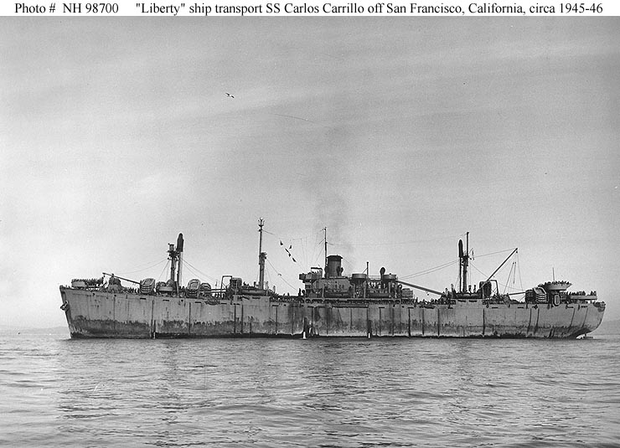
Liberty Ships
Usually cargo ships
Developed by Henry Kaiser
Featured welded hulls
Many sections prefabricated
By 1943, three entered service daily
The SS Carlos Carrillo, a Liberty ship later made into a troop carrier
Notes:
The U.S. “production miracle” included the mass production of “Liberty ships.” Used primarily as cargo or troop carriers, the Liberty ship became one of the most recognizable vessels of the U.S. Navy. Industrialist Henry J. Kaiser developed the concept and its novel construction techniques. His ability to quickly produce these ships earned him the nickname “Sir Launch-alot,” bestowed by FDR himself.
Liberty ships originated as vessels ordered by the British from the U.S. to replace ships sunk by German U-boats. While many early models used coal-fired boilers for steam propulsion, later models ran on diesel fuel. Early models featured riveted hulls, but since this significantly increased construction time as well as costs, later versions had welded hulls—previously unheard-of in ship construction. However, the use of welded hulls had its problems: In some instances, improper welds fractured in cold sea water, causing the loss of the ship. Improved welding techniques reduced this danger later in the war. Another innovation involved prefabrication: workers built various sections of the ship independently and brought them together for final assembly.
While many remarked that the ships themselves were not “attractive looking,” workers could produce them extremely quickly. It originally took more than six months to produce a single ship, but this fell to about 42 days. By 1943, three ships per day entered service.
14

Slide 15
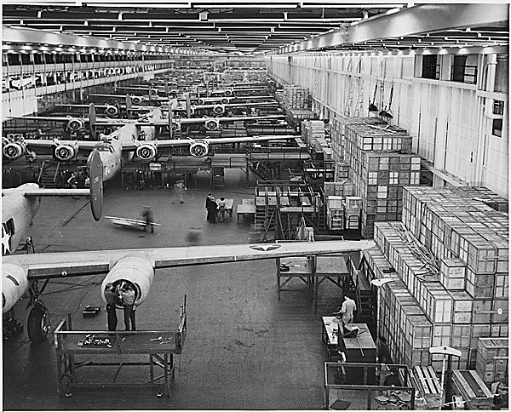
Ford’s Willow Run Facility
Built B-24 “Liberator” bombers
World’s largest factory under one roof
Produced 14 aircraft per day in August 1944
Workers at the Willow Run facility assemble B-24 bombers, 1943
Notes:
Henry Ford’s Willow Run facility provided another “production miracle,” this one with B-24 “Liberator” bombers. Built on the site of a farm owned by Ford Motor Company founder Henry Ford, Willow Run had an enormous factory floor. The main building had 2.5 million square feet of floor space. Until the construction of Chrysler’s engine plant in 1943, Willow Run was the largest factory in the world under one roof.
Willow Run had its share of criticism. The facility produced no airplanes there until July 1942, when it merely sent a single, unassembled plane to the Douglas Aircraft facility for finishing. The government did not receive the first completed plane from Willow Run until September 1942. The War Production Board (as well as a congressional oversight committee chaired by Missouri Senator Harry Truman) severely criticized delays in constructing planes. However, Willow Run soon became more effective in producing planes. Its airframe production in 1944 nearly equaled that of the entire Japanese aircraft industry; in August of that year, Willow Run was churning out 14 aircraft per day. Efficient mass-production techniques let Willow Run deliver aircraft to the U.S. military at roughly half the cost as in 1941.
15

Slide 16
Discussion Questions
What was the purpose of the Office of War Information? How did it accomplish this?
How did the film industry contribute to the war effort in the 1940s? What were some significant productions?
What techniques did Henry Kaiser introduce to dramatically increase production of Liberty ships?
Notes:
The Office of War Information was formed in 1942 to ensure coordination of war news, promote patriotism, and develop and disseminate propaganda. The OWI produced posters, motivational films, and radio shows to keep Americans focused on the war effort. It also recruited women to work in the war industry by similar means. In addition, the OWI established and ran the Voice of America radio network to broadcast a steady stream of American propaganda to Europe and in the Pacific.
Hollywood helped the war effort by providing audiences with movies that showed the evils of the Axis and highlighted the goodness of the Allied cause. Movies such as Casablanca portrayed the Germans as sadistic warmongers, while Yankee Doodle Dandy promoted patriotism on the home front. Cartoons such as Donald Duck in Nutziland put a comic spin on why Americans had to support the war effort. Life on the home front was also brought to the silver screen in films such as Mrs. Miniver and Since You Went Away. Documentary films, such as Frank Capra’s series Why We Fight also helped to maintain American interest in fighting the war.
Kaiser made two innovations in shipbuilding: First was the use of welded hulls, rather than riveted hulls, which greatly reduced the time spent on construction. The second involved prefabricating sections of the ship at different locations, then bringing them together for final assembly at a shipyard.
16

Slide 17
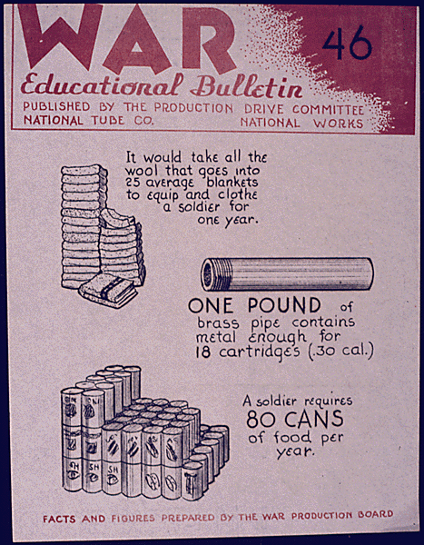
War Production Board
Ensured that the military had the resources it needed
Directed industrial output
Prohibited nonessential business activities
Allocated raw materiel
Organized scrap drives
A “War Educational Bulletin” produced by the War Production Board
Notes:
In order to coordinate the “production miracle” needed to win the war, the Roosevelt Administration created several boards and agencies which significantly altered American business and the economy during the war years. The War Production Board ensured that the military received the resources it needed to fight the war. Since the government had to acquire massive amounts of materiel to fight the Axis, it also needed to direct a large portion of industrial output to military purposes. Headed by Sears, Roebuck and Co. Chairman Donald Nelson, the WPB suspended nonessential business activities, such as the manufacture of civilian automobiles, for the duration of the war. It assigned priorities to scarce materiel and allocated raw materiel to key industries. It also organized and encouraged scrap drives to recycle waste materiel into needed goods.
17

Slide 18
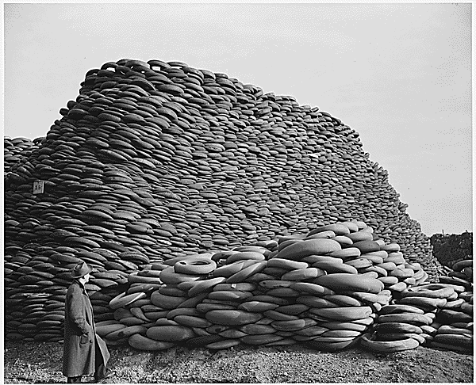
Scrap Drives
Organized by the WPB
Encouraged collection of waste and scrap goods for war use
Materiel included iron, aluminum, paper
Waste cooking fats for making glycerin
Results of a scrap rubber drive
Notes:
In addition to the War Production Board’s attempt to allocate scarce materiel to industry, it also encouraged civilian populations to recycle waste and scrap materiel for reuse as war resources. Women and children collected and turned in tons of scrap metal, aluminum, newspaper, and waste cooking fats. The U.S. government especially urged children to participate, calling them “Uncle Sam’s Scrappers,” or “Tin Can Colonels.”
The WPB estimated that 30 million schoolchildren across the nation collected 15 million tons of scrap metals. It declared that this amount of scrap metal could build 425 Liberty ships. The WPB especially prized waste cooking fats because they were used to make glycerin, an important ingredient in the manufacture of gunpowder. Making one pound of gunpowder required three pounds of glycerin; therefore, firing a 12-inch shell from a navy cannon took nearly 350 pounds of glycerin.
18

Slide 19
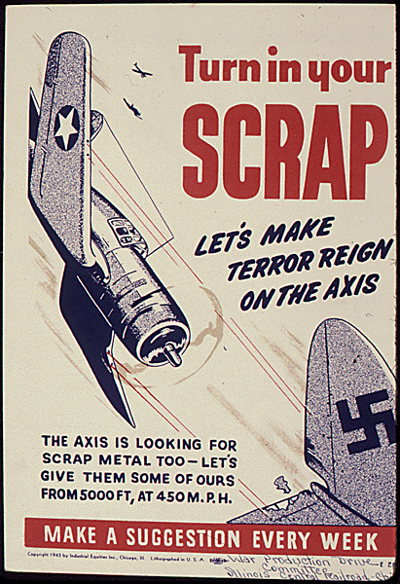
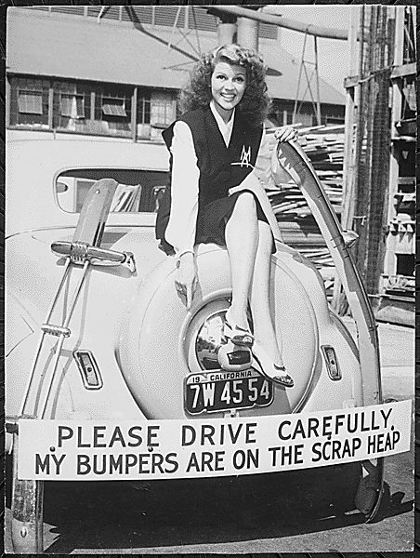
Scrap Drives: Posters
The government used posters and publicity pictures of celebrities such as Rita Hayworth (right) to encourage citizens to recycle scrap items.

Slide 20
Office of War Mobilization
Created in 1943 by FDR
Headed by James Byrnes
Became dominant mobilization agency
Byrnes worked well with labor and with the military
OWM head James F. Byrnes
Notes:
It soon became apparent that the WPB could not handle all aspects of war production, such as maintaining production of certain civilian goods while at the same time ensuring production of military supplies. To solve this issue, President Franklin D. Roosevelt created the Office of War Mobilization in 1943.
To head the new agency, Roosevelt appointed James F. Byrnes, a former Supreme Court associate justice as well as one of FDR’s closest advisers (whom many called the “assistant president”). While it didn’t abolish the War Production Board, the OWM became the more effective, dominant agency dealing with war production, primarily because Byrnes could better handle labor issues and reach compromises with the military regarding production levels.
20

Slide 21
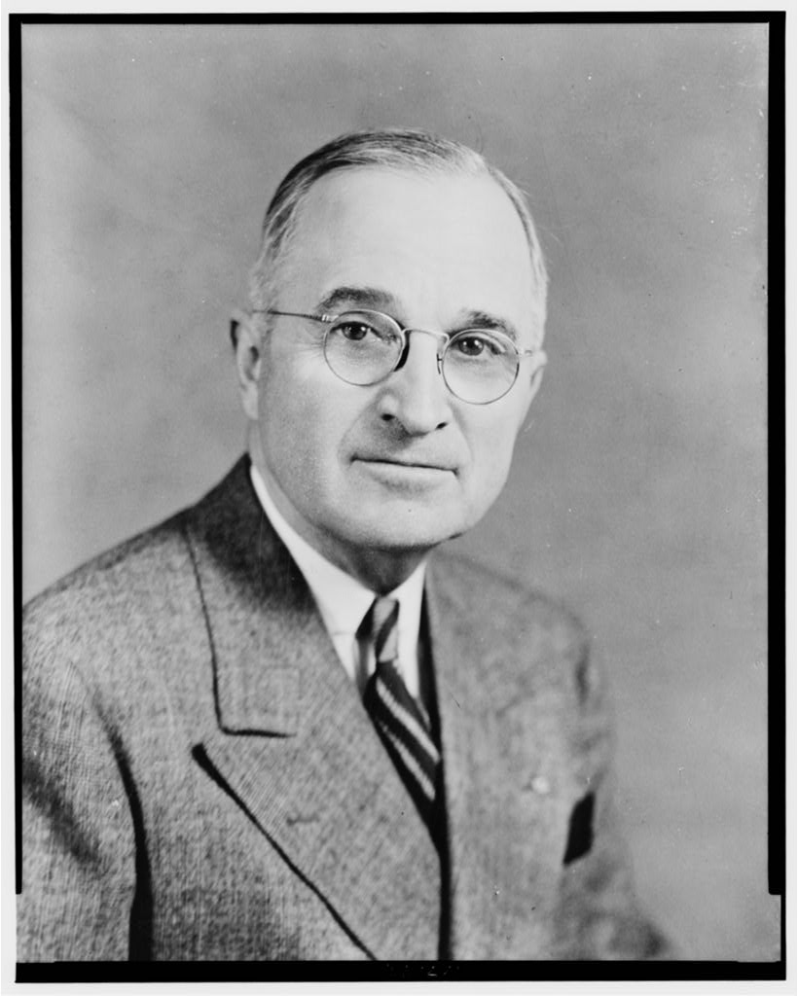
The Truman Committee
Created to expose waste and fraud in the defense industry
Truman personally inspected factories and military installations
Saved taxpayers millions
Senator Harry S. Truman
Notes:
As the government became more and more financially involved in the war effort, the Senate created an oversight committee to investigate charges of fraud and mismanagement of federal resources and money in the defense industry. Selected to lead the committee—officially, the Senate Special Committee to Investigate the National Defense Program—was Senator Harry Truman of Missouri.
Driving himself in his own Dodge automobile, Truman made several trips across the U.S. to inspect military installations and defense plants. Although Congress had only allocated $15,000 for the committee’s expenses, the Truman Committee saved taxpayers millions and did much to lessen fraud in the defense industry. Along the way, Truman made contacts with the president, and agriculture, labor, and manufacturing agencies, as well as a name for himself nationally. In 1944, supporters saw Truman as a logical choice for FDR’s running mate.
21

Slide 22
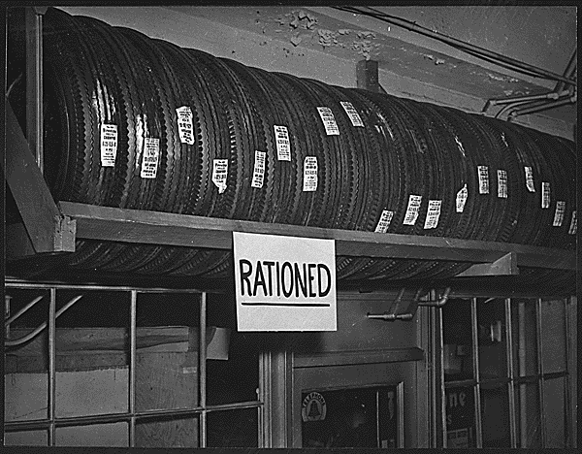
Office of Price Administration
Designed to limit wartime inflation
Established “ceiling prices” for many goods
Rationed scarce goods and many consumer staples
Rationing stopped at end of war
Dissolved in 1947
Notes:
The possibility of inflation greatly concerned the federal government. As goods became harder for the civilian population to purchase, their prices would skyrocket. Worried about the inflation’s effect on the U.S. economy, the Roosevelt Administration created the Office of Price Administration in early 1942. The OPA established “ceiling prices” for many commodities, most fixed at their March 1942 levels, above which they could not rise. The OPA froze nearly 90 percent of the nation’s retail prices during the war.
In addition, the OPA rationed what the government considered “scarce” goods. Several staples of American life, such as gasoline, automobile tires, sugar, coffee, meats, and processed foods were tightly rationed; some supplies were nearly nonexistent. Millions of Americans found themselves either substituting for scarce goods, doing without, or trying to purchase goods on the black market. With the end of the war, the OPA quickly abandoned rationing; the agency ceased to exist in 1947.
22

Slide 23
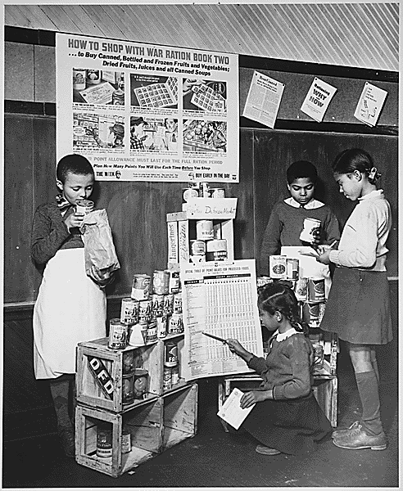
Rationing
Way to allocate scarce goods
Included meat, butter, sugar, coffee, shoes
Stamps and points system
Gasoline rationing particularly complex
Black market emerged
Children learning to tally points and ration stamps
Notes:
The government realized it needed a system for allocating goods so that both military and civilian populations could get what they needed. The response to this problem was rationing, a way to limit the purchase of scarce goods.
Some of the more contested-for rationed goods included meat, butter, sugar, coffee, canned and frozen foods, and shoes. To effectively calculate what goods the consumer might buy, the OPA devised a complicated system of stamps and points. A person without the right combination could not buy the good. Gasoline proved particularly difficult to ration. The OPA granted most motorists an “A” sticker for their car windshield, which guaranteed them four gallons of gas per week. “Essential” workers got “B” stickers entitling them to eight gallons per week. Those whose professions required them to drive (such as physicians, ministers, railroad workers, and mail carriers) received “C” stickers. “X” stickers went to government officials and public servants such as police, firefighters, and civil-defense workers. “T” stickers went to truck drivers who carried goods essential to the war effort; they could buy an unlimited supply of fuel.
Regardless of their level of patriotism, many Americans found doing without staples of daily life to be unappealing, and a robust black market soon developed to sell highly prized and highly priced goods. However, both civilian and military populations generally had the goods and materiel they needed during the war years.
23

Slide 24
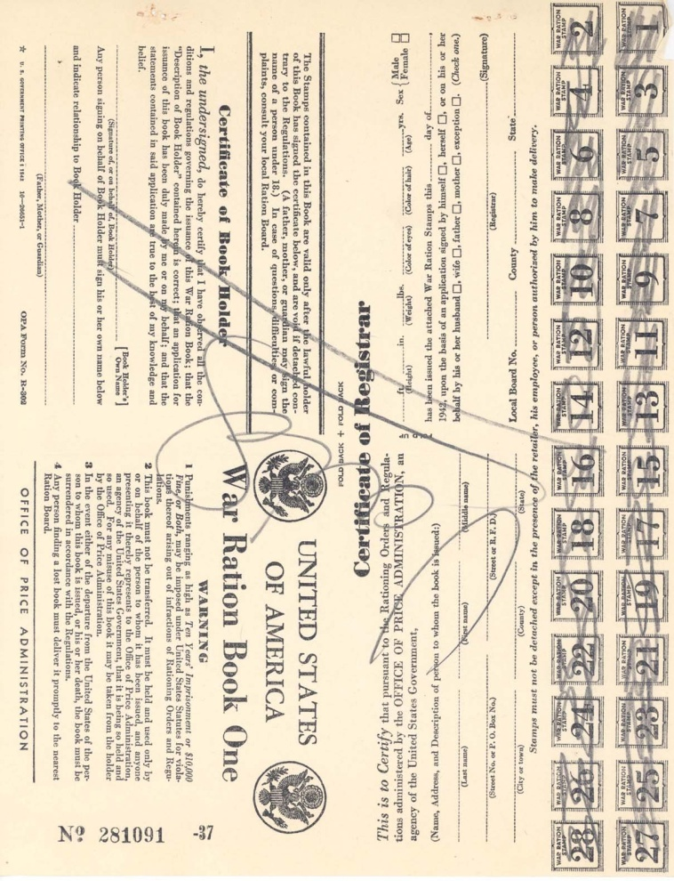
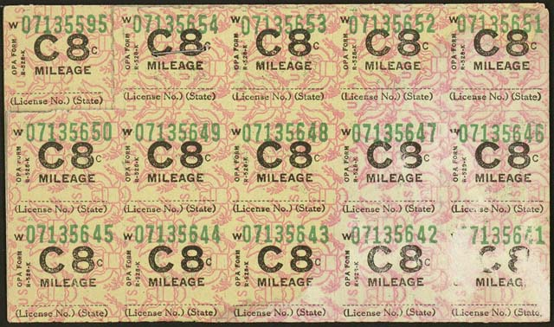
Rationing: Books and Stamps
Each family received ration books (left) and stamps (above) for determining its monthly allotment.
Notes:
The government devised a system of ration stamps and books, as well as a complex point system, to fairly determine what families and individuals could buy monthly. For example, goods such as meat, butter, fats, and cheese required red stamps; purchasing other goods, including fruits, vegetables, soup, and baby food involved blue stamps. The point system tended to frustrate many households, with some goods requiring a certain number of points, and others not needing any points. In addition to the multi-tiered system for rationing gasoline, drivers had to live with a 35 mph speed limit to conserve gas as well as tires.
Rationing ended along with the war, and all phases of it vanished by 1946.
24

Slide 25
Discussion Questions
About how much did WWII cost the U.S. government? How did the federal government raise revenue to pay for the war?
How did purchasing war bonds help the average citizen? How did they help the war effort?
How did the Office of Price Administration prevent wartime inflation? How did its system for rationing goods work?
Notes:
The U.S. government spent more than $321 billion (more than $3 trillion in today’s dollars) to fight the war—more than twice what the federal government had spent in its entire existence to this point. One way the government collected revenue was through substantially increased income tax rates, in addition to an expansion of who qualified for the income tax. The government also sold billions of dollars of war bonds (including war stamps purchased by children) to civilians, banks, and private industries.
Average Americans could invest in war bonds, which made money when the bonds matured at an interest rate higher than or comparable to other means of investment. War bonds helped the war effort by raising needed revenue and by making citizens feel as if they were directly contributing to the fight.
As goods become scarcer, prices tend to rise, making money worth increasingly less; the Office of Price Administration set the highest prices at which goods could sell, essentially freezing them at March 1942 levels. Regarding scarcity, the OPA devised a system of points and stamps for allotting staple items and other goods. With the right combination of stamps and points, a consumer could purchase their allotment of meat, sugar, or other items.
25

Slide 26
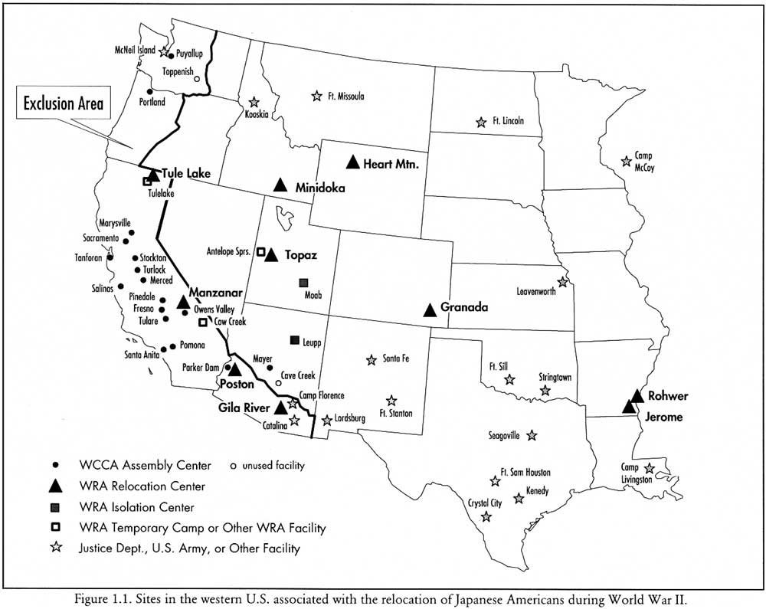
Japanese American Internment
FDR issued Executive Order 9066
Removed more than 110,000 Issei (Japanese nationals) and Nisei (Japanese Americans) from the West Coast
About two-thirds were citizens
A map of relocation centers in the western U.S.
Notes:
Wartime civil-defense measures such as blackouts and air-raid drills prepared Americans for attacks that never occurred, but did little more than inconvenience people. However, the federal government instituted a program to maintain national security that proved far more damaging—the relocation of about 120,000 Japanese nationals (called Issei) and Japanese American citizens (Nisei) to internment camps across the interior of the western U.S.
In early 1942, FDR issued Executive Order 9066, which allowed for the exclusion from “military areas” anyone deemed a threat to national security. Designating the West Coast a “military area,” the government removed all persons of Japanese ancestry (along with a few thousand Germans, Italians, and German Jews). Many Americans, especially on the West Coast, supported the policy, contending that they had likely assisted the Japanese navy in planning and carrying out the attack on Pearl Harbor, and might help facilitate future attacks.
26

Slide 27
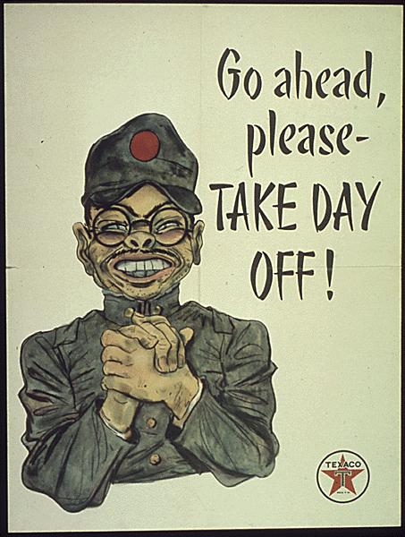
Prejudice Against Nisei
Long history of anti-Japanese sentiment in California
Falsely accused Nisei of helping plan Pearl Harbor
No evidence of sabotage or espionage ever found
This propaganda poster displays typical American-held stereotypes of the Japanese
Notes:
The fear of Japanese Americans came not only from Japan’s attack on Pearl Harbor, but also from deep-seated prejudices against Nisei. Increasing Japanese immigration to California beginning the late 19th century had resulted in legislation in some cities similar to the Jim Crow laws of the American South. Reports of Japanese atrocities against the Chinese in the early 1930s further lowered public opinion of the Japanese. Groups of farmers in California resented having to compete with “foreigners” and wanted to take over their land.
However, no concrete evidence of Japanese American espionage or sabotage was ever uncovered during the war; no convictions on such charges ever materialized. In addition, Hawaii did not implement the relocation policy, and no incidents of espionage or sabotage occurred there.
Discussion question:
Ask students to view the poster included on the slide. What elements display stereotypes of how Americans viewed the Japanese and Japanese Americans? (Student answers should include the thick eyeglasses, buck teeth, and the pidgin English that many movies and radio shows used to imitate the Japanese; some may mention the rumpled uniform as typical of anti-Japanese propaganda.)
27

Slide 28
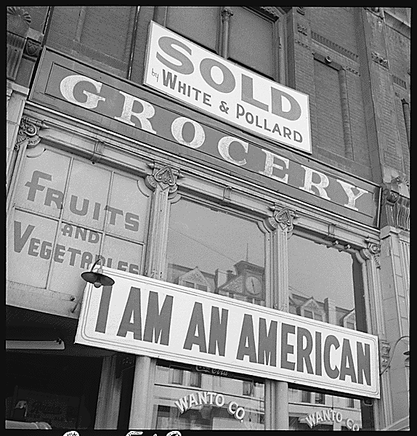
“I Am an American”
Some Nisei tried to demonstrate patriotism
Interned regardless
Most Japanese accepted internment
Wanted to show their loyalty to the U.S.
Despite this Oakland, California, grocer’s sign, he was interned and his business sold
Notes:
Some Nisei made a last-ditch attempt to prove their patriotism by posting large signs on their businesses and homes denoting their citizenship. Most were interned anyway. Even under the difficult conditions they endured in the camps, most accepted their fate and submitted to internment, hoping that compliance might prove their loyalty to the U.S.
28

Slide 29
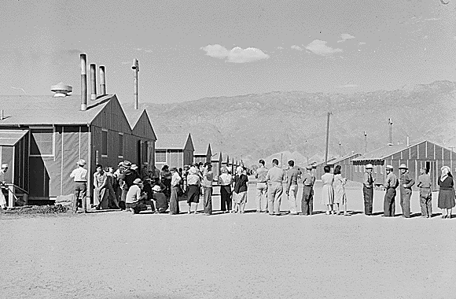
Life in the Camps
Nisei forced to sell homes, businesses, property
Lost an estimated $2 billion
Poor conditions:
Barbed-wire enclosures
Barracks with cots and no plumbing
Meager food budget
Low temperatures
Notes:
Japanese Americans, faced with their immediate removal from cities on the West Coast, found themselves forced to sell their homes, businesses, and personal possessions for whatever they could get. The Nisei together lost an estimated $2 billion in property.
A 1943 War Department report noted that the internees were housed in “tar paper covered barracks of simple frame construction without plumbing or cooking facilities of any kind.” The Heart Mountain, Wyoming, relocation camp greeted internees with barbed-wire fences, toilets with no partitions, cots rather than beds, and a food budget of 45 cents per day. Temperatures at Heart Mountain frequently dropped to below zero during the winter months, and since many of the internees were not told where they were going, they did not include winter clothing in their belongings.
Note to teacher: You may play the video clip included on the CD-ROM about the propagandist view of camps such as Manzanar. Ask students who they think the government’s target audience was for films such as this one.
29

Slide 30
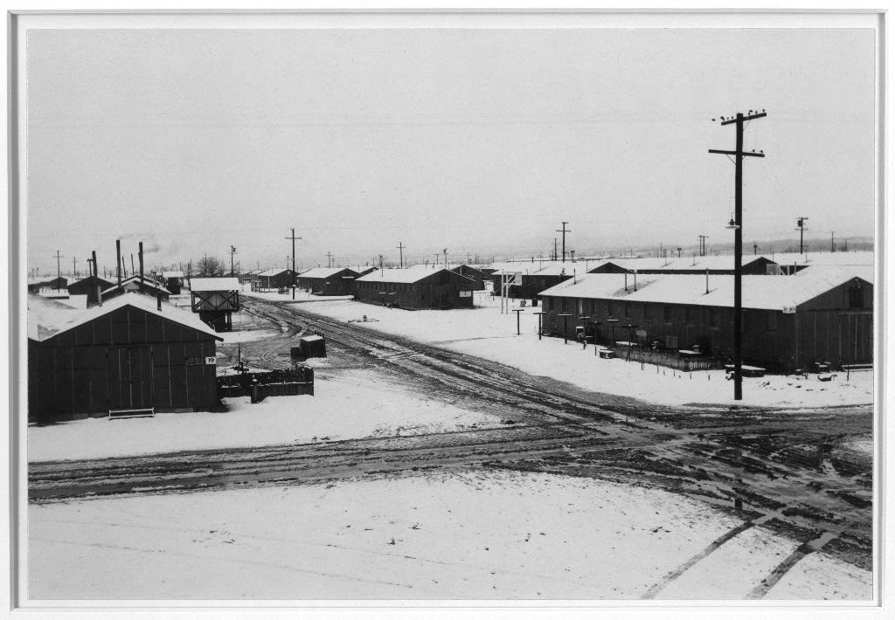
Manzanar
Located in California
Best known of relocation camps
Camp held nearly 12,000 internees
Extremes in climate
Closed in November 1945
Manzanar in the winter
Notes:
Perhaps the best known of all the concentration camps was Manzanar, located in the foothills of the Sierra Nevada Mountains in the Owens Valley region of California. At its height, it housed nearly 12,000 internees.
The climate there ranged widely, with extremely hot desert summers and winter temperatures frequently falling below freezing at night. High winds frequently posed a problem, especially considering the shoddy construction of most of the camp’s barracks. Internees generally ate food similar to what soldiers received, with little meat due to rationing. However, residents of the camp started a chicken farm and hog farm to supplement their diets.
Three months after the Japanese surrendered in World War II, the government closed Manzanar. Internees received $25 for train or bus fare. Some had to be removed from the camp because they did not have any place to go to after the war. It was declared a National Historic Site in 1992.
30

Slide 31
Korematsu v. U.S. (1942)
Korematsu refused to obey the relocation order
Appealed conviction on constitutional grounds
Supreme Court ruled the order a valid use of presidential power in wartime
Decision vacated in 1984, due to government-withheld evidence in the first trial
Notes:
One challenge to the relocation order came from Fred Korematsu, a Japanese American from San Leandro, CA, who refused to obey the relocation order. Authorities arrested him and put him in a relocation camp with his family until trial. He was convicted in federal court and sentenced to five years’ probation. With help from the American Civil Liberties Union, Korematsu appealed his conviction until it reached the U.S. Supreme Court.
In 1942, the Supreme Court ruled 6–3 against Korematsu, stating that Roosevelt’s order requiring relocation of Japanese Americans was a valid use of his power as commander-in-chief of the armed forces. However, Justice Frank Murphy’s scathing dissent noted that “the exclusion of Japanese falls into the ugly abyss of racism,” and equated relocation with the same type of racism exhibited by the Axis Powers.
In the early 1980s, documents came to light showing that the federal government had purposely withheld key evidence that might have cleared Korematsu, including documents proving that Japanese Americans had never posed any meaningful risk to national security. In 1984, a federal appeals court vacated the original judgment (that is, declared that Korematsu’s conviction had never legally happened), citing a WWII-era government report condemning the case for interment as having been based on “willful historical inaccuracies and intentional falsehoods.” The appeals court, however, did not overturn the Supreme Court’s decision concerning the president’s war powers.
In 1998, President Bill Clinton awarded Korematsu with the Presidential Medal of Freedom for his ongoing work in the field of civil rights. Fred Korematsu died in 2005.
31

Slide 32
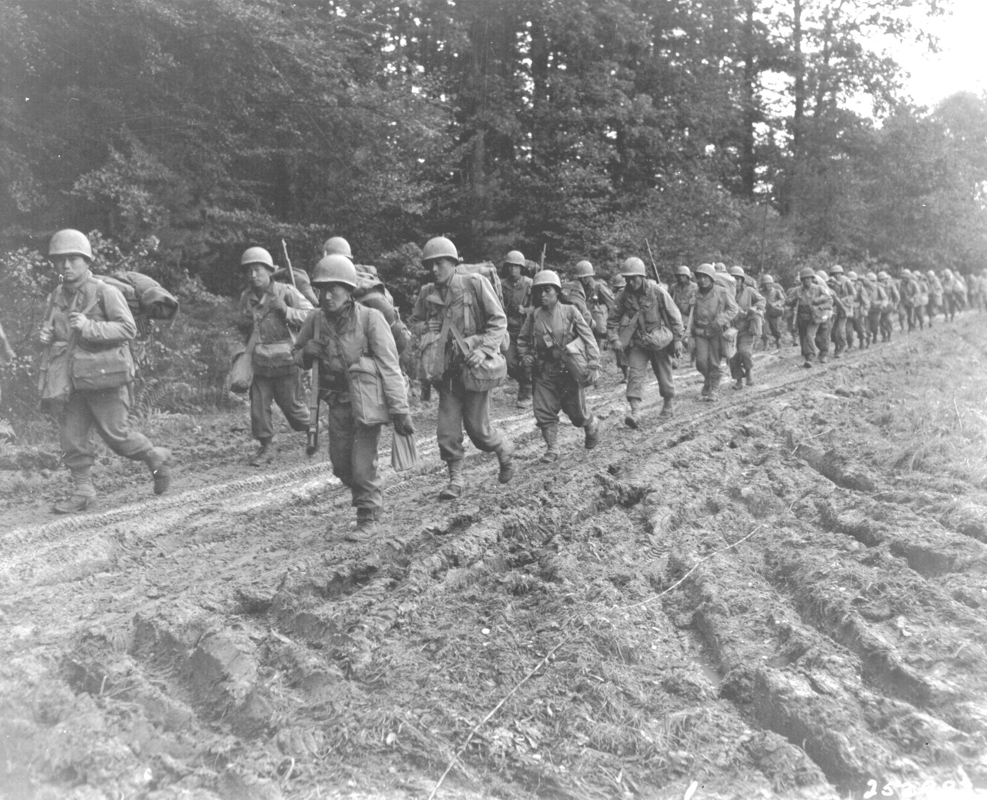
The 442nd Regimental Combat Team
Formed in 1943
Made up of Nisei
Fought with distinction in Italy and France
Most decorated combat unit in U.S. history
Members of the 442nd hiking through France, late 1944
Notes:
While many Nisei went to relocation camps across the West, some decided on enlisting in the armed forces as the best way to protest against concerns about their patriotism. The 442nd Regimental Combat Team (known as the “Go for Broke” regiment) became one of the best known and most well-respected army units during the war.
The government originally excluded Nisei from the armed forces, but had reversed its policy by 1943, accepting some from relocation camps and many from National Guard units in Hawaii. Trained at Camp Shelby, Mississippi, the 442nd was deployed in September 1944, and soon saw action in the Italian campaign, including Anzio. More than half of the unit became casualties during their Italian service. While a few Nisei served as intelligence agents in the Pacific Theater, the military prohibited them from fighting against Japan. German Americans and Italian Americans had no such restrictions placed on their service.
After the liberation of Rome, the 442nd assisted in the invasion of southern France. In the Italian and French campaigns combined, the unit saw an extraordinarily high casualty rate, with some sources estimating casualties (including cases of trench foot and various injuries) as high as 93 percent, giving the 442nd the nickname, the “Purple Heart Battalion.”
At the end of the war, the 442nd became the most decorated unit in U.S. military history, with more than 18,000 awards and medals earned, including more than 9000 Purple Hearts. Soldiers from the 442nd also were awarded 21 Congressional Medals of Honor; the unit as a whole received seven Presidential Unit Citations for its service in the European Theater.
32

Slide 33
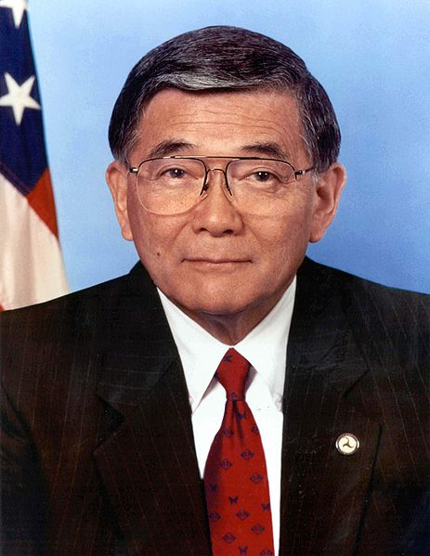
Civil Liberties Act of 1988
Sponsored by Simpson and Mineta, a former internee
Government formally apologized
Paid $20,000 to each surviving internee
1992 act added enough money to cover all remaining internees
Government apologized again
Norman Mineta
Notes:
The federal government acknowledged its error of interning Japanese Americans with the Civil Liberties Act of 1988. Wyoming Senator Alan Simpson and California Congressman Norman Mineta sponsored the bill—the two had met at a Boy Scout function while Mineta was interned in a Wyoming camp. The act, signed by President Ronald Reagan, stipulated that the U.S. government formally apologize for the internment. It also authorized a cash payment of $20,000 to each surviving internee; nearly $1.2 billion was distributed.
A subsequent act, the Civil Liberties Act of 1992, added another $400 million to ensure that all living internees would receive the reparations. The act, passed by President George H.W. Bush, again formally apologized for Japanese American internment.
33

Slide 34
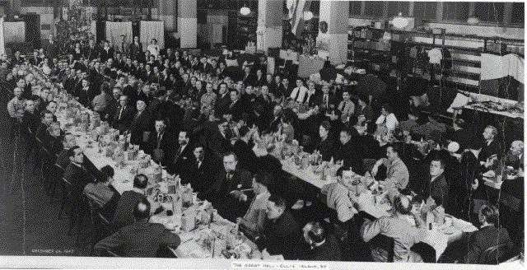
Internment of Other Groups
German Americans and nationals, and Italian Americans and nationals
More than 10,000 Germans and 3000 Italians interned
Camps similar to those for Nisei
No evidence of espionage or treason
German American and Italian American internees at Ellis Island, 1943
Notes:
The government also interned German Americans and Italian Americans during the war, although in much smaller numbers than Japanese Americans. The Japanese American internment overshadowed the FBI and the Immigration and Naturalization Service’s program to remove what it saw as German and Italian security threats from of the mainstream U.S. population. As with the Japanese Americans, the vast majority were American citizens.
Various locations, including Ellis Island in New York as well as sites in Maryland and Tennessee, became internment camps. Best estimates say that the government held more than 10,000 Germans and 3000 Italians. As with the Nisei, the German and Italian internees were shopkeepers, farmers, and businessmen, not diplomats or people involved in government service. No evidence of espionage activity or sabotage by those investigated or interned has ever come to light. Few records of German American or Italian American internment survive (or have been released), though several persons have attempted to uncover more information.
34

Slide 35
African Americans and the War
The irony of fighting a racist regime in Europe while experiencing racism at home
Blacks found limited employment in defense plants
Race riots broke out in many cities
African Americans looked for equality in the workplace and in the military
Notes:
African Americans, who had been experiencing discrimination long before the war, found that conditions did not change substantially for them during the war years. Many struggled with the grim irony of helping to defeat a racist enemy in Europe while facing the effects of racism and discrimination at home. In addition, the U.S. military itself had segregated units.
Many African American workers could not find good jobs at defense plants because of their color. Those who did secure employment frequently received lower salaries than whites. Blacks who migrated to cities in search of defense jobs found housing scarce. Northern blacks unaccustomed to Jim Crow laws had difficulty adjusting to the culture of Southern industrial cities.
This migration of African Americans resulted in friction between whites and blacks which frequently boiled over into violence. In the summer of 1943, race riots erupted in 47 cities. In Detroit, riots claimed the lives of 25 blacks and nine whites, with hundreds of persons injured.
However, African Americans also looked for ways that they could ensure equality both on the battlefield as well as at home.
35

Slide 36
The “Double V” Campaign
Created in 1942 by the Pittsburgh Courier, a leading black newspaper
Called for “victory over our enemies at home and victory over our enemies on the battlefields abroad”
The campaign’s logo
Notes:
One of the earliest organized protests against the discrimination of African Americans came in the form of the “Double V” campaign, led by the Pittsburgh Courier, one of the leading black newspapers of the era. The campaign called for two victories: “victory over our enemies at home and victory over our enemies on the battlefields abroad.” The Courier asserted that the time had come to “persuade, embarrass, compel, and shame our government and our nation…into a more enlightened attitude.” Courier reader James G. Thompson of Wichita, Kansas, had proposed the idea in a letter to the editor, while staff artist Wilbert T. Holloway designed the “Double V” logo. Soon, “Double V” clubs sprang up nationwide, and other newspapers backed the campaign editorially.
After the war, the Courier continued with a “Single V” campaign: while the war had ended with victory over the Axis, victory over those who discriminated against African Americans in the U.S. had yet be realized.
36

Slide 37
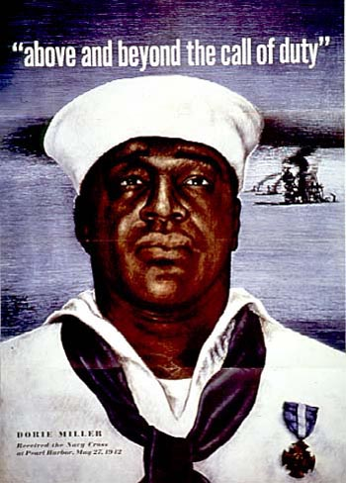
Dorie Miller
A hero of the Pearl Harbor attack
Not initially recommended for any commendation
Later received Navy Cross
Killed in the invasion of the Gilbert Islands
A poster featuring Miller
Notes:
The bravery and valor of many African American soldiers and sailors during World War II were frequently overlooked, such as the case of Doris “Dorie” Miller, who distinguished himself during Pearl Harbor. Miller was serving as a cook onboard the USS West Virginia when the Japanese attacked on December 7, 1941. When the alarm sounded, Miller immediately reported to his battle station but found it destroyed by a torpedo. Instead, Miller was ordered to help carry wounded sailors to aid stations. Seeing West Virginia Captain Mervyn Bennion wounded on the deck, Miller personally carried him to safety. Captain Bennion refused medical treatment and insisted on continuing his command; he bled to death during the attack. Miller then fired a 50-caliber machine gun (which he wasn’t trained to use) at attacking Japanese planes. When the Japanese finally sank the West Virginia, Miller and other sailors abandoned ship.
The navy awarded other sailors medals for valor but initially overlooked Miller, although he eventually received the Navy Cross (the navy’s third-highest honor). Captain Bennion posthumously received the Medal of Honor. The Pittsburgh Courier frequently called for Miller to be allowed stateside to participate in war-bond tours. The navy awarded no African American the Medal of Honor during World War II. Only in 1997 did seven African Americans receive the medal, six posthumously.
Miller continued his service as a mess cook. In 1943, a Japanese torpedo hit his ship during the invasion of the Gilbert Islands, sinking it in minutes. More than 200 sailors managed to escape; Miller did was not one of them.
37

Slide 38
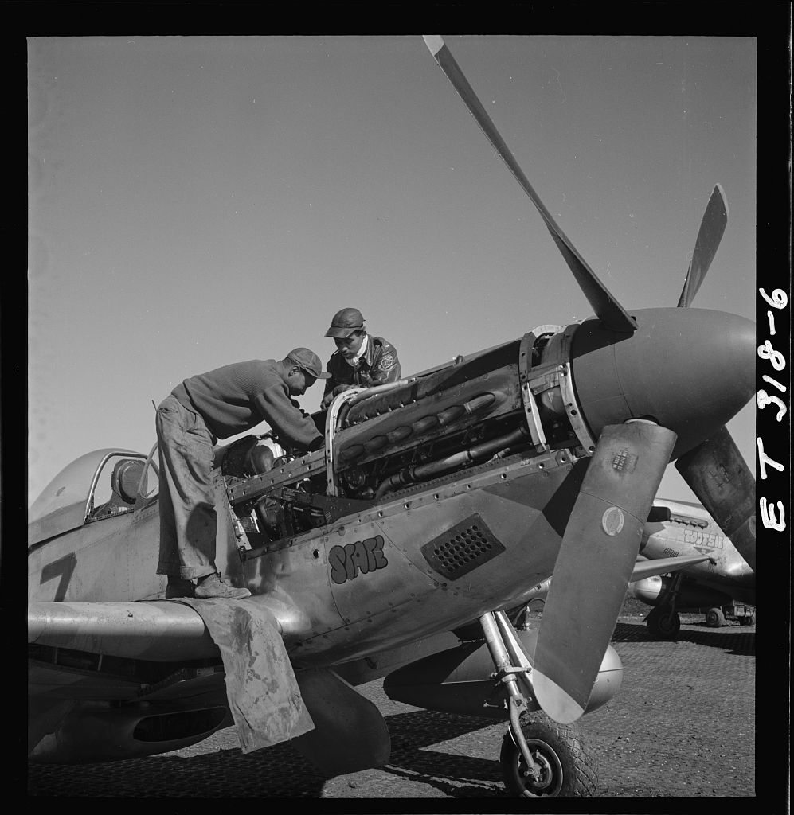
The Tuskegee Airmen
All-black combat unit formed in 1941
99th Fighter Squadron formed in AL
Commanded by Davis
Escorted bombers over central Europe
Proved superior or equal to white pilots
Airmen Marcellus G. Smith and Roscoe C. Brown in Italy, 1945
Notes:
Just as the 442nd Regimental Combat Team proved Japanese Americans to be as skilled in combat as white troops, the Tuskegee Airmen demonstrated the abilities of African Americans. The Army Air Corps formed an all-black unit in 1941, under congressional pressure. The War Department tried to thwart the plan by requiring that recruits either had flight experience or a higher education. A large number of African Americans nonetheless met the requirements and enlisted in the program. The Army Air Force established the 99th Fighter Squadron at Alabama’s Tuskegee Institute, selecting Captain Benjamin O. Davis, Jr. (one of the few black West Point graduates) to command the squadron.
A white officer commented in a Time magazine article that the black pilots were inferior to white pilots. Following a congressional committee hearing, a subsequent evaluation of all pilots in the Mediterranean Theater showed the Tuskegee pilots to be equal to or better than other P-40 pilots.
Tuskegee Airmen who escorted bombers in missions over central Europe shot down more than 100 enemy aircraft. Many claimed for years after the war that the Airmen did not lose a single plane they escorted, though later evidence proved that some bombers were lost. However, many point to the real achievement of the Tuskegee Airman as proving that African Americans could perform just as well as white pilots.
38

Slide 39
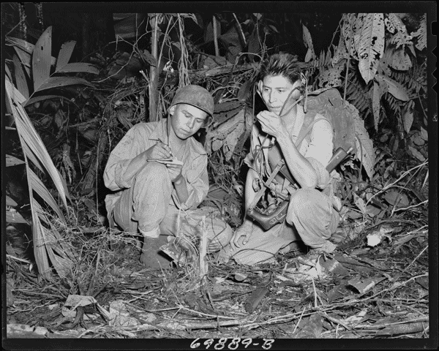
The Navajo Code Talkers
Used to transmit messages in the Pacific Theater
Based on the Navajo language
Navajo words frequently substituted for military terms
Code never broken
Code Talkers Henry Bake and George Kirk send messages in the Pacific Theater, 1943
Notes:
Native Americans also served with distinction in WWII, some of whom provided a unique, essential service—the Navajo Code Talkers. These soldiers helped to develop and transmit an unbreakable code for the American military in the Pacific Theater. Phillip Johnston, the son of a Protestant missionary, came up with the idea to use Navajo after reading a newspaper story about the military’s search for an “unbreakable code” to communicate sensitive material. The U.S. military had some success with Cherokee and Choctaw in World War I for this purpose. Johnston had spent most of his childhood around the Navajo people and knew the difficulty of learning their language.
The military had some major concerns, especially how to translate modern military terminology into Navajo. The Code Talkers handled this problem by simply substituting Navajo words for military terms. For example, “tank” became the Navajo word for “tortoise,” and “airplane” became “bird.” The Marines created an entire list of terminology for converting the Navajo language into military use.
The group of 29 Code Talkers in May 1942, grew to more than 400 by 1945. They never wrote in code, so each had to memorize the system. Code Talkers joined Marine units in the Pacific and served in several major battles, including Guadalcanal and Iwo Jima. Due to their physical resemblance to Japanese, the Code Talkers were sometimes assigned guards so they would not be confused with the enemy. In the end, the Japanese never broke the Navajo code.
Twenty-nine Code Talkers received the Congressional Gold Medal in 2001. The rest were similarly honored in 2007.
39

Slide 40
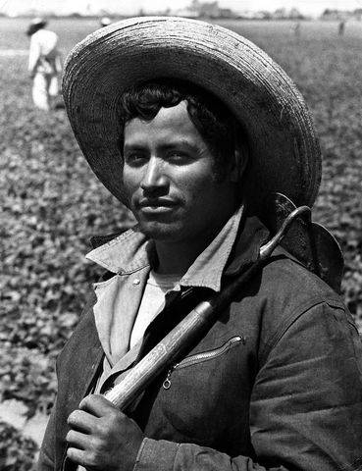
The Bracero Program
Established due to wartime labor shortage
Experienced Mexican laborers brought in for CA farm work; expanded nationwide
Braceros also worked for U.S. railroads
Reported human rights abuses
Lawsuits filed to collect savings withheld from braceros’ pay
A bracero
Notes:
The shortage of wartime labor due to military service, especially in agriculture, prompted the U.S. government to look outside of the country for help. The U.S. and Mexico agreed upon the Bracero Program, which in 1942 began to bring in skilled Mexican laborers (or braceros) to work as farmhands in the southwestern U.S.
Soon, braceros were working across the U.S. not only in agricultural jobs, but also alongside skilled and unskilled workers in the railroad industry. The government later instituted a quota of 50,000 agricultural workers and 75,000 for the railroads. By war’s end, braceros were no longer contracted for railroad service, but continued in agricultural jobs until 1964. The government closed the program amid reports of significant human rights abuses against the braceros.
From the inception of the program until 1948, braceros brought several lawsuits against U.S. agricultural employers, mainly to recover money from “savings accounts” established by payroll deduction. The program had stipulated that the braceros would receive this money upon their return to Mexico, but most did not receive them. Most of the lawsuits were dismissed because the banks involved in the transactions were not located in the U.S.
40

Slide 41
“Zoot Suit Riots”
Los Angeles, 1943
Conflicts between sailors on leave and young Mexican Americans, identifiable by their dress
African Americans and Filipinos wearing zoot suits also targeted
Military eventually placed LA off-limits to servicemen
A zoot suit
Notes:
Another example of racial discord during WWII came in the form of the “Zoot Suit Riots,” which occurred in Los Angeles in May 1943. The riots began when U.S. sailors on leave clashed with young Hispanics. One sailor was stabbed, and soon hundreds of Marines and sailors were roaming the streets, looking for anyone wearing a “zoot suit”—a suit with wide lapels, baggy pants, padded shoulders, and often a wide-brimmed hat and watch chain. While mostly young Mexican Americans wore zoot suits, so did members of other minorities, such as Filipino and African Americans, who also became targets. The local press took the side of the military, calling the zoot suiters “hoodlums.” The uproar subsided when military commanders in Los Angeles declared the city off-limits to military personnel, with those violating the order subject to arrest by Shore Patrol officers.
41

Slide 42
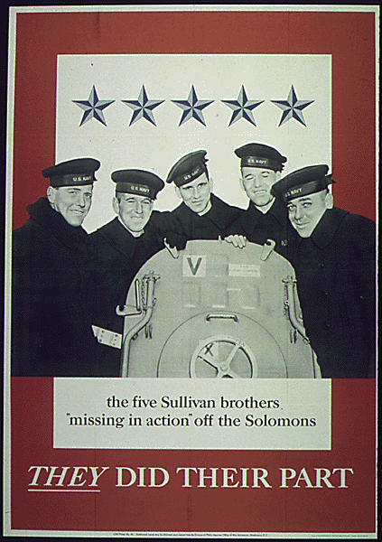
The Sullivan Brothers
From Waterloo, IA
Enlisted in the Navy on the condition they would serve together
Assigned to the USS Juneau
All five killed at Guadalcanal in 1942
Notes:
Losing a family member in the war was a concern that affected nearly everyone. However, while many families lost a loved one, no family suffered as much as the Sullivan family of Waterloo, Iowa. All five sons were killed in action in 1942, during the Battle of Guadalcanal. The Sullivan brothers, aged 20 to 27, all volunteered for active duty in the U.S. Navy soon after Pearl Harbor, on the condition that they be allowed to serve together. The Navy had a regulation prohibiting family members to serve together, but did not strictly enforce it; the brothers were assigned to the light cruiser USS Juneau.
A Japanese torpedo damaged the Juneau at Guadalcanal. Another torpedo hit the ship’s powder magazine as it was leaving the battle area. The Juneau broke apart and sank in less than a minute. Other ships in the area believed all on board to have been killed, but 100 sailors went into the water after the sinking. The Navy sent no search crews for several days, and once the survivors were finally spotted, only 10 remained; the rest had succumbed to the elements as well as to shark attacks.
Three of the Sullivan brothers died in the torpedoing and sinking, another died the next day, and the last died four or five days later. Due to the magnitude of the family’s sacrifice, the Sullivan brothers became nationally mourned. President Roosevelt sent a personal letter of condolence, as did as Pope Pius XII. The Navy later named two destroyers after the brothers, both called The Sullivans.
42

Slide 43
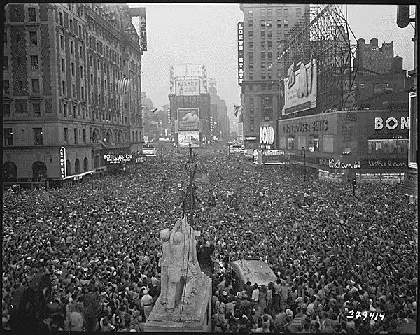
V-E Day and V-J Day
Victory in Europe, May 6–7, 1945
Victory Over Japan, Sept. 2, 1945
Celebrations marked the end of the war
Nation still had to deal with postwar issues
Tens of thousands crowd Times Square to celebrate the Japanese surrender, New York City
Notes:
A few weeks after Roosevelt’s death, Hitler committed suicide in his bunker under the streets of Berlin. With the Soviet Army closing in on the city, Germany finally surrendered on May 6th and 7th, 1945 (it took two days for all treaties to be signed). With the surrender of Germany, most expected that the military would reassign most of the troops fighting in the European Theater to the Pacific for the eventual invasion of the Japanese mainland.
In August 1945, the atomic bombings of Hiroshima and Nagasaki convinced the Japanese to surrender without an Allied invasion. Nearly six years after World War II began in Europe, the Japanese formally surrendered aboard the USS Missouri, ending the war.
Americans across the nation celebrated the end of the war, though many had serious concerns. In some instances, families anxiously waited for information about loved ones listed as missing in action; others were dealing with the death in action of a family member. Still others saw an uncertain future, with so many servicemen returning to look for jobs and wanting to start families and further their education.
43

