Slide 1
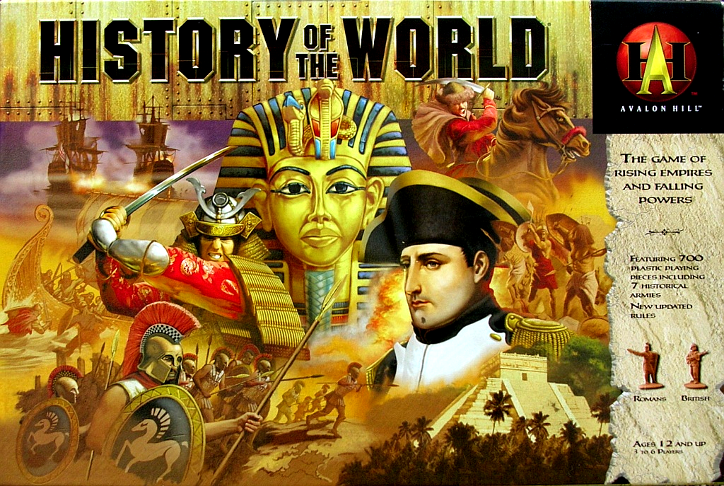
Welcome to World History

Slide 2
Course Themes
As we study history, we must focus on 5 major themes for each unit we study
These themes are…

Slide 3
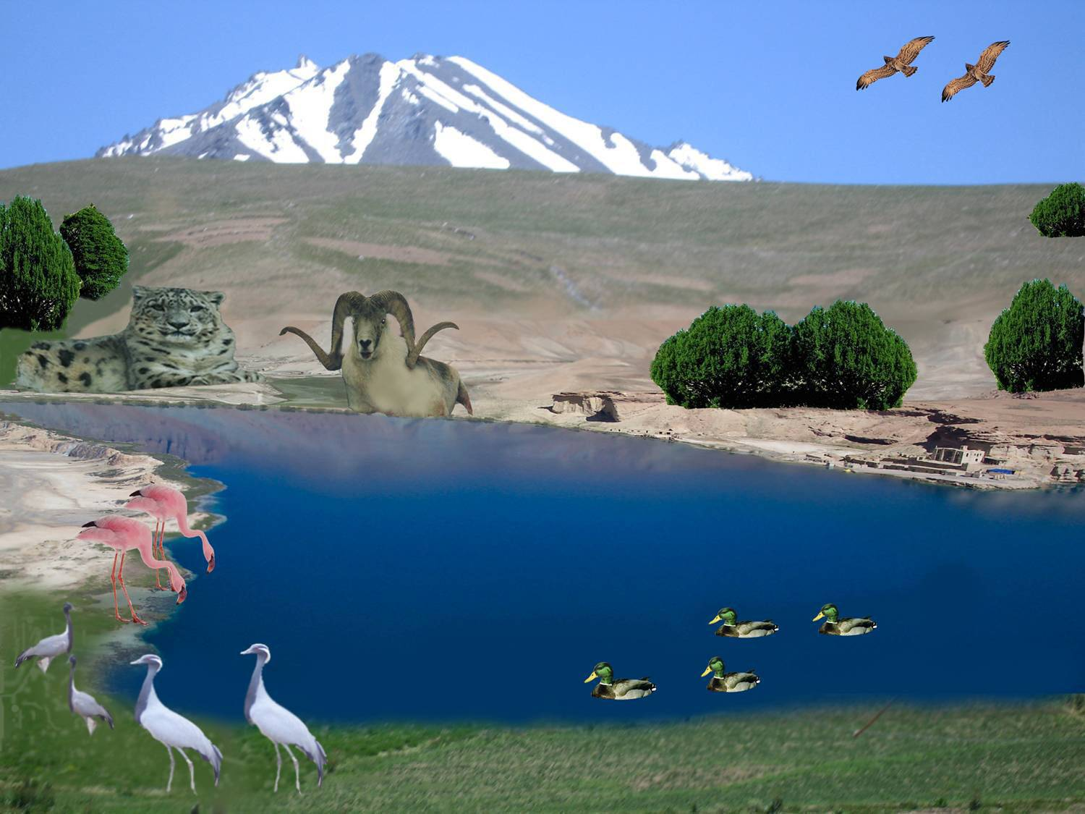
Theme 1 - Environment
Interactions between humans and the environment
Demography (population) and disease
Migration
Patterns of Settlement
Technology

Slide 4
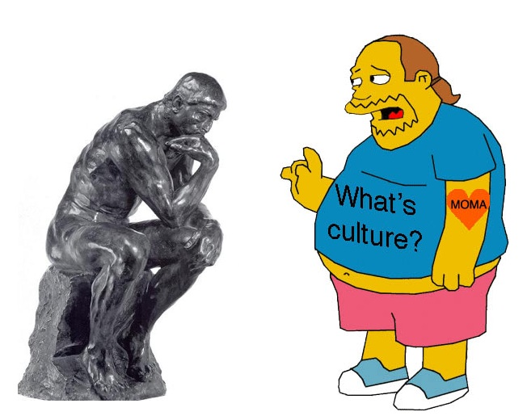
Theme 2 - Culture
Development and interactions of cultures
Religions
Belief systems, philosophies, ideologies
Science and technology
Arts and architecture

Slide 5
Theme 3 - Politics
State building, expansion, and conflict
Forms of government
Empires
Nations and nationalism
Revolts and revolutions
Regional, transregional, and global structures and organizations

Slide 6
Theme 4 – Economics
Creation, expansion, and interaction of economic systems
Agriculture and pastoral production
Trade and commerce
Labor systems
Industrialization
Capitalism and socialism

Slide 7
Theme 5 – Sociology
Development and transformations of social structures
Gender roles and relations
Family and kinship
Racial and ethnic constructions
Social and economic classes

Slide 8
P.E.C.E.S
We’ll use term P.E.C.E.S. to remember the 5 themes
Politics
Environment
Culture
Economics
Sociology

Slide 9
Important Info/Tips
Use my website (have to go to Salk site)
Keep up with course work and do reading/assignments
Read slow, take notes
Don’t be absent and actively participate in class

